Slide 1
STUDENT NAME – Afreen Taj K REGISTER NO – 711721243005 DEPARTMENT – B.Tech Artificial Intelligence and Data Science
Rice Classification using CNN
3/21/2024 Annual Review

Slide 2
PROJECT TITLE : Rice Classification using CNN
3/21/2024 Annual Review

Slide 3


AGENDA
Problem Statement
Project Overview
End Users
Our solution and Proposition
Key Features
Modelling Approach
Results and Evaluation
Conclusion
3/21/2024 Annual Review

Slide 4

PROBLEM STATEMENT
Errors in manual sorting procedures result in varying rice quality, adversely affecting producers, distributors, and consumers alike.
Ineffective classification methods lead to economic losses by underestimating the value of high-quality rice and discarding lower-grade varieties, impacting financial viability across the supply chain.
Precise rice classification is crucial for reducing waste and promoting sustainability. By efficiently utilizing rice across different grades, it fosters environmental stewardship and resource optimization.
3/21/2024 Annual Review

Slide 5
PROJECT OVERVIEW
The objective of the Rice Classification System is to create a highly efficient and precise automated platform that categorizes rice according to a range of quality factors.
This system meets the demand for uniform quality control, aligning with market requirements, and securing the economic sustainability of the rice sector.
Identifying and removing contaminants and impurities from rice safeguards consumer health by reducing potential health hazards.
Enhancing efficiency in rice processing expedites delivery to consumers, ensuring timely access to quality products
3/21/2024 Annual Review

Slide 6

WHO ARE THE END USERS?
Agricultural researchers and scientists
Farmers and agricultural workers
Food processing companies
Agricultural technology companies
Government agencies and policymakers
3/21/2024 Annual Review

Slide 7

YOUR SOLUTION AND ITS VALUE PROPOSITION
Our proposed solution involves implementing a Convolutional Neural Network (CNN) architecture, trained on a dataset comprising labeled images featuring various rice varieties.
Utilizing automated image analysis to accurately classify rice varieties and assess their quality with precision.
Improves agricultural practices and fosters progress in computer vision technology.
Improves seed selection efficiency and guarantees the quality of rice products through enhanced operational effectiveness.
3/21/2024 Annual Review

Slide 8

THE WOW IN YOUR SOLUTION
Automating image analysis revolutionizes the way rice is classified
Instantaneous and accurate assessment of rice variety quality with precision and speed.
By empowering stakeholders ranging from farmers to policymakers, it enhances the decision-making process.
Boosting food security and sustainability through the application of technology
3/21/2024 Annual Review
8

Slide 9
MODELLING
Convolutional Neural Networks (CNNs) for Rice Classification:
CNNs are well-suited for tasks such as rice classification because they possess the capability to autonomously learn and extract hierarchical features from images, making them highly effective in image classification scenarios..
Data Preprocessing for Rice Classification:
Load the rice grain images from the dataset, making sure to pair each image with its corresponding rice type label for supervised learning.
Standardize the image sizes to dimensions like 224x224 pixels, maintaining the aspect ratio to meet CNN input specifications and enhance model compatibility..
Normalize the pixel intensities of the images to a scale between 0 and 1, promoting uniformity across data samples and assisting training algorithms in achieving better convergence and performance.
Training Process for Rice Classification:
Train the CNN model using mini-batch stochastic gradient descent (SGD) or the Adam optimizer to optimize model parameters and minimize training loss.
Evaluate the model's performance on the validation set to assess its ability to generalize to new data and detect any signs of overfitting or underfitting.
3/21/2024 Annual Review
9

Slide 10
MODELLING
Fine-Tuning for Rice Classification:
Freeze the weights of the initial layers in the pre-trained CNN to retain the valuable learned features without further modification during training.
Allow the top layers of the CNN to adapt to the rice classification task by unfreezing them, enabling weight updates during training to better capture rice-specific features.
Fine-Tuning: Fine-tune the model on the rice dataset using a lower learning rate compared to the initial training to prevent drastic changes to the pre-learned features.
Model Evaluation for Rice Classification:
.Accuracy: Compute the classification accuracy of the trained model on the test set to measure its overall performance
Precision, Recall, F1-Score: Calculate precision, recall, and F1-score for each class to assess the model's performance on individual rice types.
Confusion Matrix: Generate a confusion matrix to visualize the model's performance in terms of true positive, false positive, true negative, and false negative predictions for each class.
3/21/2024 Annual Review
10

Slide 11
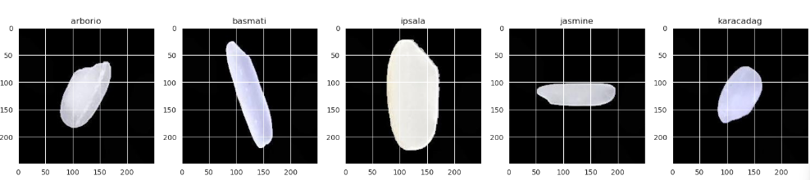
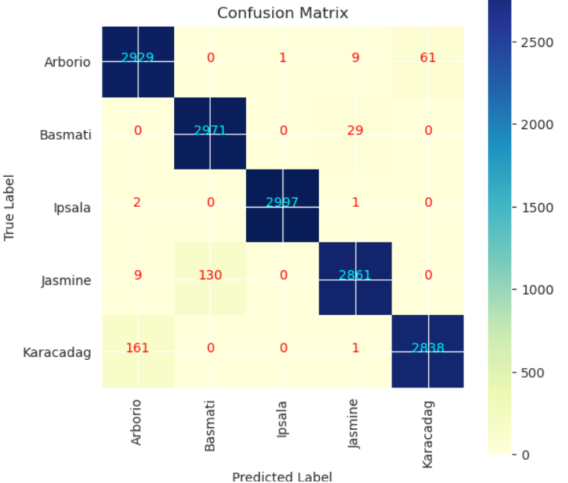
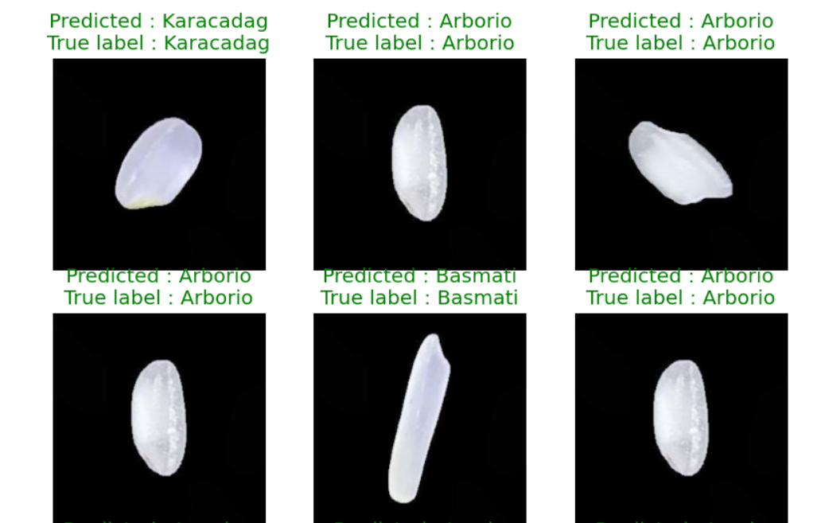
RESULTS
3/21/2024 Annual Review
11

